Slide 1
Intuilize – Cluster Commanders Customer Segmentation & Prediction Weekly Meeting 4/23/2025
Andy, Graham, Keertana, & Shashank

Slide 2
Questions
T-Mobile Example – Suggestions?
Markov-Chain input and output.
Previous progress document was completed and sent.
Client evaluation will be sent Friday.
Fall 25 project scoping
Email was sent asking you and Nelson to select a project to continue into the next semester.

Slide 3
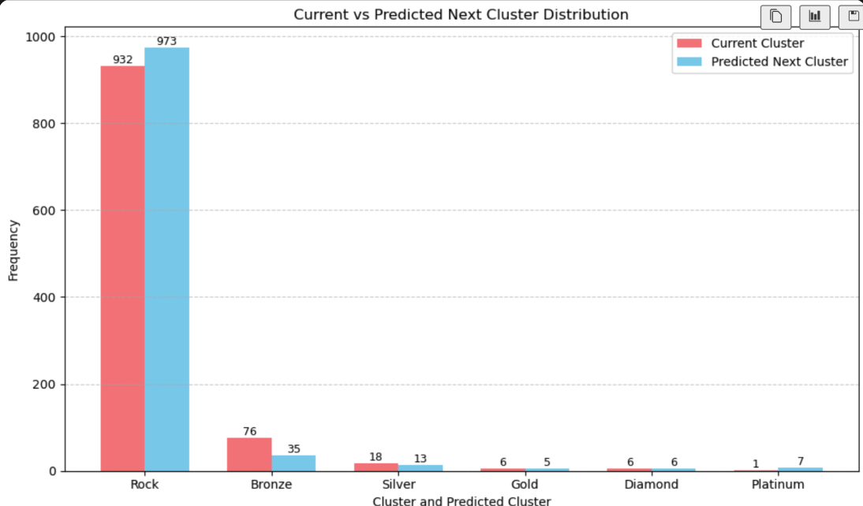
Questions

Slide 4
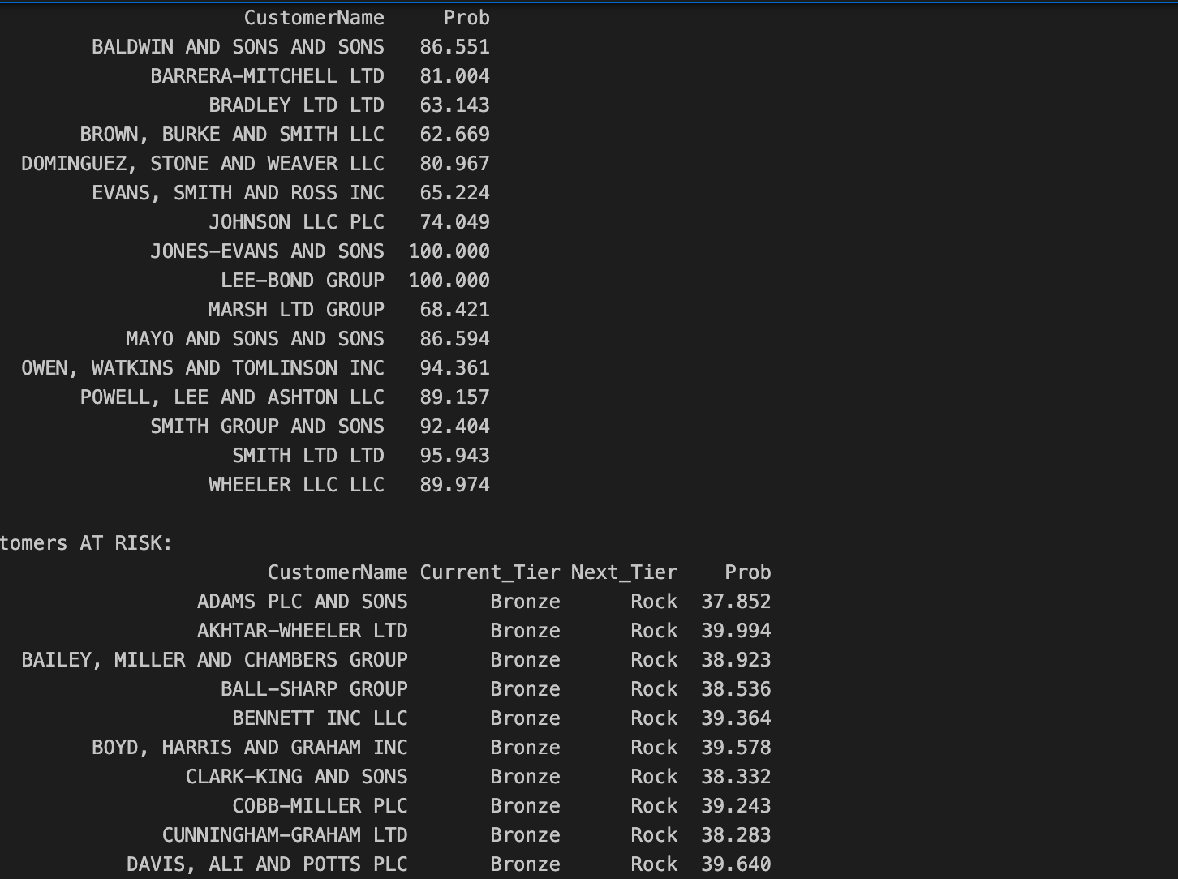

Slide 5
THANK YOU!

